Slide 1



REFIK CAN OZTAS
CMP 656: ADVANCED COMPUTER AND NETWORK SECURITY
UNDERSTANDING ANDROID APP PIGGYBACKING: A SYSTEMATIC STUDY OF MALICIOUS CODE GRAFTING

Slide 2

APK, ANDROID AND PIGGYBACKING

Slide 3
INTRODUCTION
MOTIVATION
CONTRIBUTION
Investigate piggybacked apps for understanding how piggybacking performed
Contribute to the research community efforts by building and sharing the first publicly available dataset on piggybacked apps

Slide 4
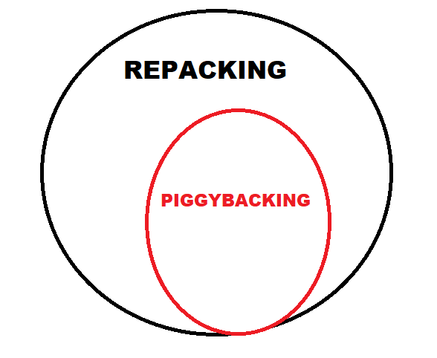
TERMINOLOGY

Slide 5
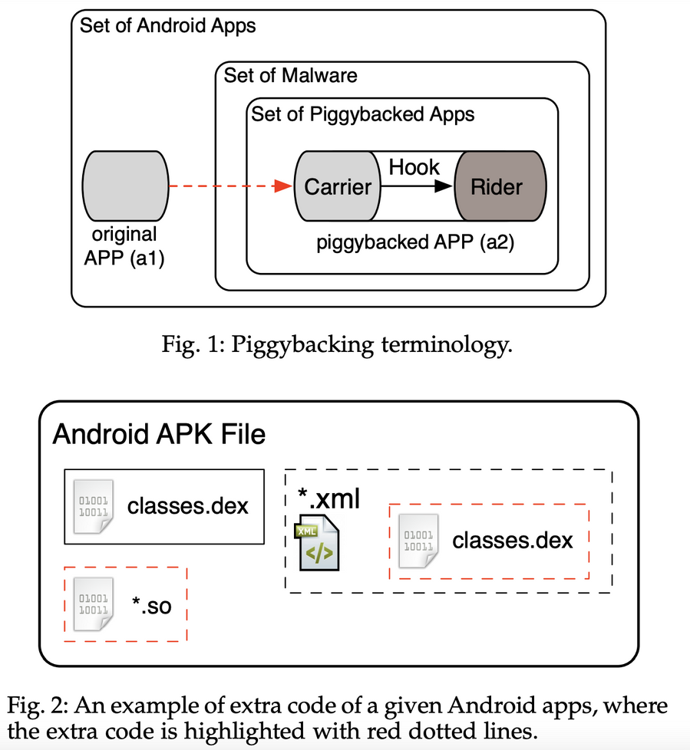
TERMINOLOGY

Slide 6
DATASET COLLECTION -> PROCESS
DATASET =
MARKETS (GOOGLE PLAY, APPCHINA, ANZHNI) +
OPEN SOURCE REPOS (F-DROID)
+
RESEARCHER DATASET (MALGENOME)

Slide 7
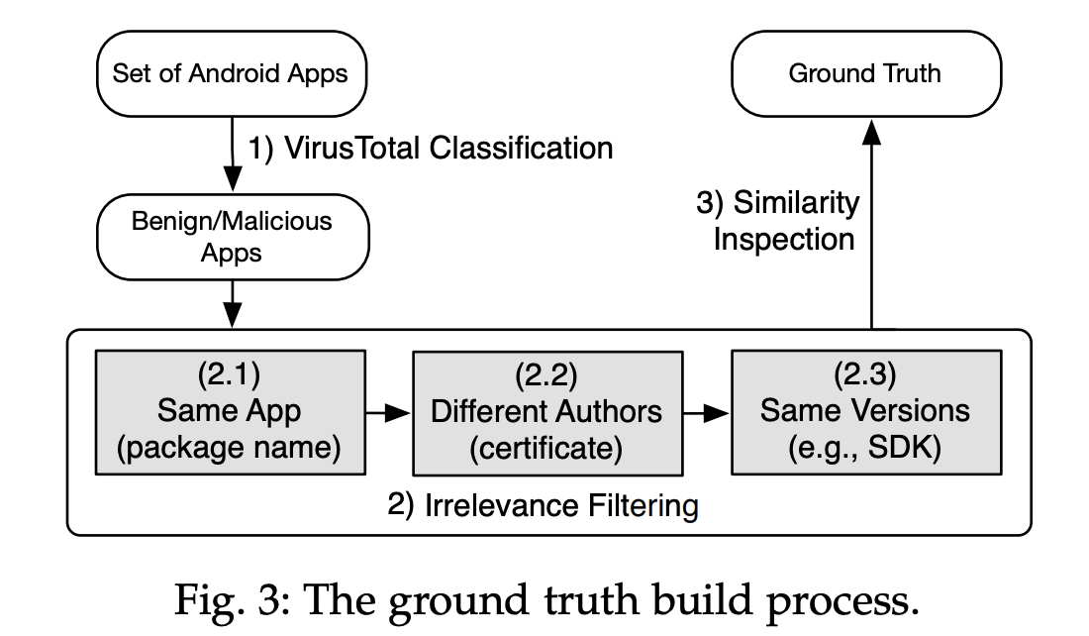
DATASET COLLECTION -> PROCESS

Slide 8
DATASET COLLECTION -> PROCESS
INITIAL CLASSIFICATION USING VIRUSTOTAL REPORTS:
FILTERING FOR PIGGYBACKING PAIRS:
VALIDATION OF PIGGYBACKING PAIRS:
Send all apps to VirusTotal to collect anti-virus scanning reports.
Classify apps into two subsets based on VirusTotal results: benign and malicious.
Step 2.1: Filter apps based on the Application Package name recorded in the Manifest file. Focus on pairs of benign and malicious apps with the same package name (about 540,000 pairs).
Ensure the creation date of the benign app precedes that of the malicious app.
Step 2.2: Discard pairs where both apps are signed with the same developer certificate (reducing the subset to about 70,000 pairs).
Step 2.2: Discard pairs where both apps are signed with the same developer certificate (reducing the subset to about 70,000 pairs).
Step 2.3: Focus on pairs where piggybackers do not modify version numbers and do not entirely re-implement functionality requiring new SDK versions.
Consider pairs where both apps share the same version number and SDK requirements (resulting in a dataset of 1,497 app pairs).
Perform a similarity analysis to validate the relevance of each pair as a piggybacking pair.
Expect that, given a pair of apps <appg, appm>, appg’s code is part of appm, and appm includes new code constituting the malicious payload.
Compile a final ground truth dataset of validated piggybacking pairs based on the results of the similarity analysis.

Slide 9
DATASET COLLECTION -> SIMILARITY ANALYSIS
Compute the following four metrics that have already been adopted by state-of-the-art tools such as Androguard
• identical – a given method including both signature and implementation is exactly the same in both apps.
• similar – a given method has slightly changed (at the instruction level) between the two apps, i.e., methods with same signature but with different contents.
• new – a method has been added in the piggybacked app, i.e., methods exist in app2 but not in app1.
• deleted – a method has been deleted from the carrier code when including it in the piggybacked app, i.e., methods exist in app1 but not in app2.

Slide 10
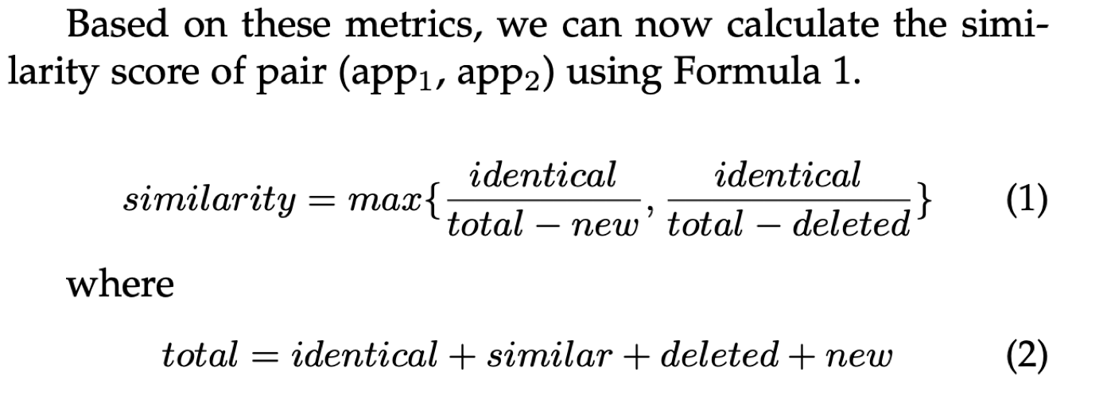
DATASET COLLECTION -> SIMILARITY ANALYSIS

Slide 11
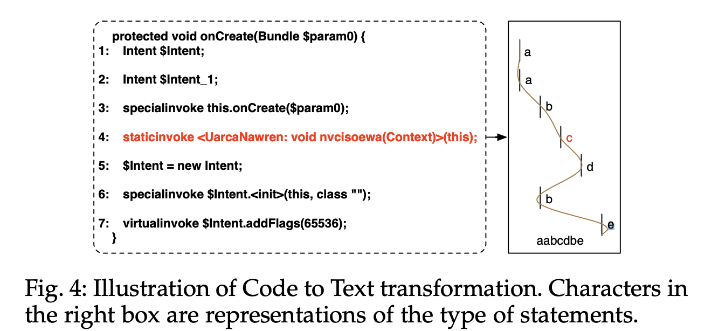
DC -> SA ->CODE TO TEXT REPRESENTATION

Slide 12
DC -> SA ->GROUND TRUTH INFERENCE
The study refined the dataset by validating code similarity within piggybacking pairs, filtering out those below an 80% threshold, more stringent than the 70% threshold in previous research. Additionally, cases lacking added code were removed, resulting in a final ground truth dataset of 950 app pairs.

Slide 13
DC -> SA ->HOOK AND RIDER IDENTIFICATION
This method delves into characterizing piggybacking by identifying similar methods between app pairs. When a method, say 'm', exists in two artifacts ('a1' and 'a2') with differing implementations, our analysis takes a detailed approach. It meticulously localizes the added, changed, or deleted statements of 'm' in 'a2' concerning 'a1'. These distinct statements are seen as hooks, linking the malicious code of the malware writer to the original app ('a1'). The rider code is then inferred as the collection of added methods and classes within the control-flow graph that are accessible from these hook statements.

Slide 14
DC -> SA -> IMPLEMENTATION
1. Framework and Language:
- Implement the similarity analysis in Java using the Soot framework.
- Soot is designed for analyzing and transforming Java/Android apps.
2. Code Representation:
- Conduct the code-to-text representation at the Jimple level, an intermediate representation in Soot.
- Jimple provides a small set of statement types, making it advantageous for analysis.
3. Bytecode Transformation:
- Use Dexpler, integrated into Soot, to transform Android Dalvik bytecode to Jimple.
- This transformation facilitates the subsequent analysis.
4. Statement Type Assignments:
- Leverage Jimple's limited set of statement types to assign a printable character to each type.
- This assignment aids in the analysis by providing a clear and manageable representation of statements.

Slide 15
DATASET CHARACTERIZATION
METADATA =
CREATION DATE + DESCRIPTION + CATEGORIZATION + DOWNLOAD COUNT
(FROM MANIFEST FILE AND SPECIALIZED WEBSITES)

Slide 16
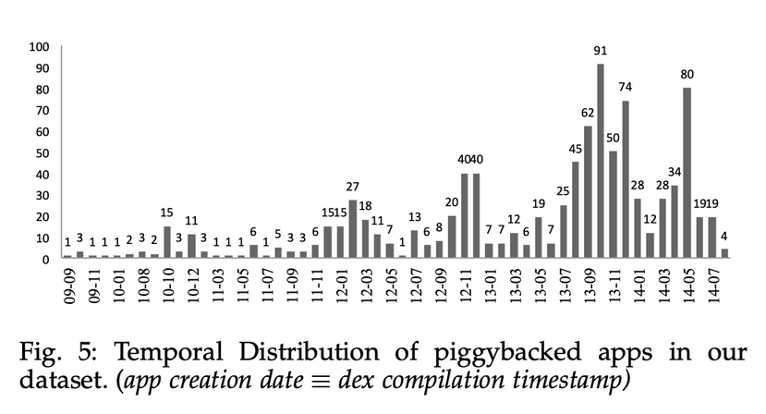
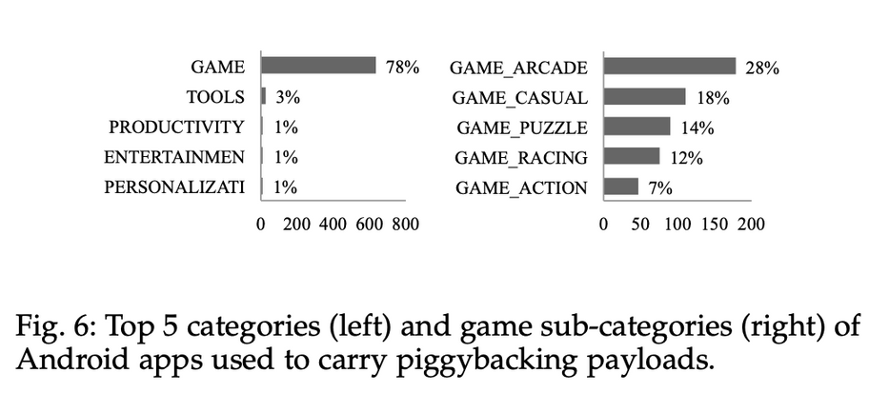
DATASET CHARACTERIZATION
TEMPORAL DISTRIBUTION OF OUR DATASET
VARIETY OF APP CATEGORIES
As illustrated in Fig. 5, our dataset contains piggybacked apps from a period of 6 years. At the time of writing, Androzoo dataset and associated antivirus (AV) reports were limited to apps until mid-2014. We performed our study on the available apps, but committed to continuously update the dataset of piggybacking pairs as new samples get archived in Androzoo. (cf. Section 5.3 on the mitigation of this threat to validity).
Statistics of app categories, illustrated in Fig. 6, show that Game apps are the most represented in our piggybacked datasets. A random sampling on our dataset of 2 million apps shows that Games also constitute the largest category of apps. Our dataset of piggybacking pairs further includes piggybacked apps from a variety of 22 categories such as Productivity, Tools, Entertainment, Personalization, Social Networking, Shopping, Sports, Weather, Transportation or News.

Slide 17
DATASET CHARACTERIZATION
DISTRIBUTION CHANNELS
POPULARITY OF APPS
Piggybacked apps from our dataset were found in several markets. While many were distributed on alternative markets such as anzhi (71%) and appChina (14%), some are actually spread via the official Google Play market (2.2%).
The distribution of download counts of original apps in piggybacking pairs and of a random sample of benign apps from Google Play, shows that mainly popular apps are leveraged by malware writers to carry their malicious payloads

Slide 18
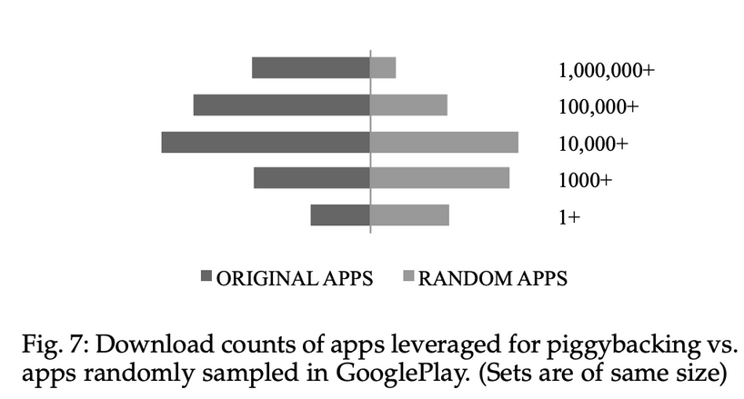
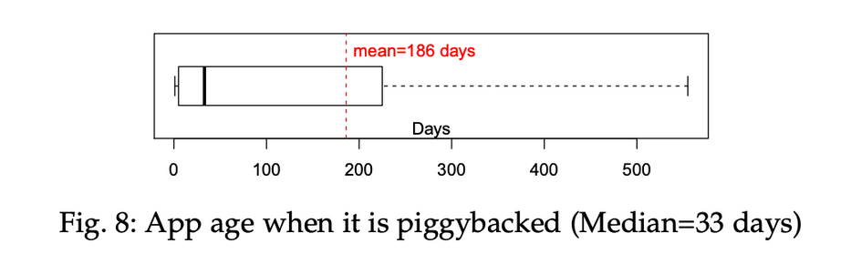
DATASET CHARACTERIZATION
VARIETY OF MALICIOUS BEHAVIOUR
PIGGYBACKING DELAY
For each piggybacking pair, we compute the time difference to explore the time delay before an app is leveraged for piggybacking. Distribution 10 in Fig. 8 shows that piggybacking operation can be done on apps of any age, with a median delay of 33 days. On average however, malware writers wait half a year before using a “known” app to spread malicious payload.
Study gathered antivirus reports from approximately 50 antivirus engines through VirusTotal for piggybacked apps. These apps were categorized based on over 1000 distinct labels provided by antivirus programs, serving as proxies for the types or families of malware. Despite variations in naming systems across antivirus engines, the extensive range of labels indicates a diverse array of malicious behaviors implemented within the piggybacked payloads.

Slide 19
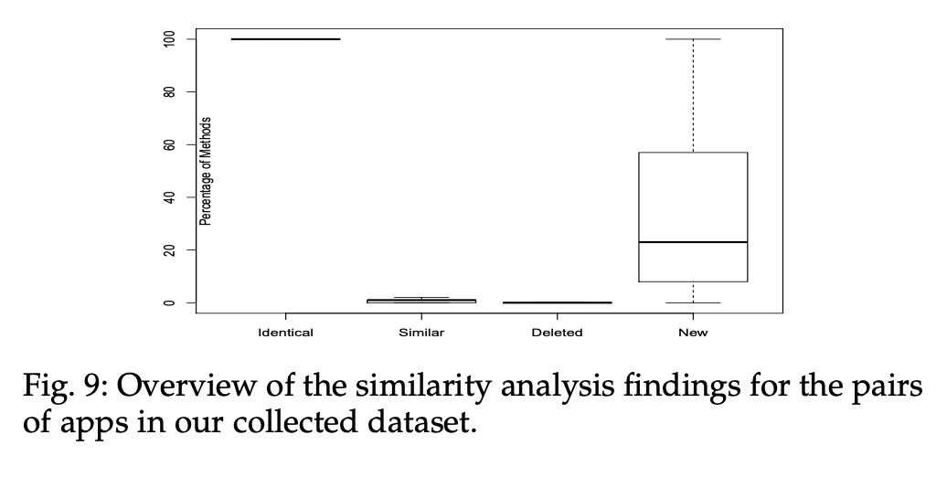
DATASET CHARACTERIZATION
PIGGYBACKING PAIR SIMILARITY
Fig. 9 plots the similarity analysis results of our collected dataset. Generally, a small amount of methods in carrier are modified in the piggybacked code and the remaining methods are kept identical. In most cases, piggybacked apps also introduce new methods while piggybacked apps remove methods from the original carrier code in only a few cases.

Slide 20
UNDERSTANDING OF PIGGYBACKING:
DIMENSIONS OF DISSECTION
WHICH APP ELEMENTS ARE MANIPULATED BY PIGGYBACKERS?
An Android application package comprises a classes.dex file containing the main code for app functionality. In addition to code, the APK file includes icons, background images, layout description XML files, and various resource files like library Jar files. Malware writers prioritize image and layout resources to maintain the desired appearance. The Manifest file specifies launcher activity and component lists, crucial for piggybacking to ensure transparent installation on user devices and seamless triggering of malicious code.
RQ-01 Are resource files as much concerned by piggybacking operations as app bytecode?
RQ-02 What types of resources are included in the malicious payload?
RQ-03 Are rider code samples redundant across piggybacked apps?
RQ-04 What changes are applied to the Manifest file during piggybacking?
RQ-05 What developer certificates can be found in piggybacked apps?

Slide 21
UNDERSTANDING OF PIGGYBACKING:
DIMENSIONS OF DISSECTION
Android apps consist of four main components:
1) Activity: Represents the visible part of Android apps.
2) Service: Executes tasks in the background.
3) Broadcast Receiver: Waits for user-specific or system events.
4) Content Provider: Provides structural data access.
The significance of these components varies for spreading malicious payloads. Components use Intents for information exchange. When the Android OS resolves an implicit intent, it looks for registered components with Intent filters matching the intent action. Intent filters declare app capabilities, and piggybacked apps may introduce new capabilities to deceive users into triggering malicious behavior. Additionally, every Android app needs permissions to access sensitive resources, and if the malicious code interacts with more sensitive resources than the original app, new permissions must be requested in the Manifest file.
HOW APP FUNCTIONALITY AND BEHAVIOUR ARE IMPACTED?
RQ-06 Does the malicious payload require extrapermissions to execute?
RQ-07 Which types of components are more manipulated in piggybacking?
RQ-08 Is piggybacking always performed manually for every target popular app?
RQ-09 What kind of actions, encoded in Intents, are created by piggybacked rider code?
RQ-10 Are there new sensitive data leaks performed for the piggybacking needs?

Slide 22
UNDERSTANDING OF PIGGYBACKING:
DIMENSIONS OF DISSECTION
WHERE MALICIOUS CODE IS HOOKED INTO BENIGN APPS?
To evade detection, malware writers strategically graft malicious rider code onto benign carrier code in Android apps. This is achieved through two main types of hooks: Type1, which modifies carrier code to insert specific method calls connecting to rider code without altering the Manifest file, and Type2, involving rider components that need to be registered in the Manifest and can be independently launched. The investigation focuses on understanding the extent to which piggybackers use hooks to ensure rider code execution, including both Type1 and Type2 hooks. Additionally, piggybackers may employ dynamic loading to avoid static detection of malicious behavior. The rider code itself can deliver malicious behavior from various families.
RQ-11 Is the injected rider code complex?
RQ-12 Is the piggybacking rider code limited to the statically accessible code?
RQ-13 How tightly is the rider code integrated with the carrier code?
RQ-14 Are hook code samples specific to each piggybacked app?
RQ-15 What families of malware are spread via piggybacking?

Slide 23
UNDERSTANDING OF PIGGYBACKING:
FINDINGS
The findings of the investigation into the outlined research questions (F1 to F20) are presented. Each finding is summarized with a take-home message before delving into the detailed analysis. When comparing characteristics of piggybacked apps with original apps, statistical significance is ensured through the Mann-Whitney-Wilcoxon (MWW) test, a non-parametric test suitable for the experimental setting. The significance level considered in this study is α = 0.001.

Slide 24
THE REALISATION OF MALICIOUS BEHAVIOUR IS OFTEN ACCOMPANIED BY A MANIPULATION (I.E., ADDING/REMOVING/REPLACING) OF APP RESOURCE FILES
F1
1. Dataset Inclusion Criteria:
- Exclusive focus on piggybacking cases with code modifications.
2. Shift in Investigation:
- Investigation targeted the treatment of other app elements during piggybacking.
3. Resource File Additions:
- 91% of piggybacked apps introduced new resource files.
4. Resource File Preservation:
- A mere 6% of piggybacked apps maintained original resource files.
5. Resource File Removal:
- Image files, Java serialized objects, plain text files, and XML files were frequently altered.
6. Renaming vs. Removal Insight:
- Cases of resource file removal often equated to file renaming.
- Renaming extended to file names, extensions, and parent directories.
7. Identification Evasion Strategies:
- Piggybackers aimed to evade identification using resource-based similarity analysis.
8. Exemplar Similarity Scores:
- In a specific pair, resource-based similarity was 72.3%.
- Code-based similarity reached a high of 99.9%.

Slide 25
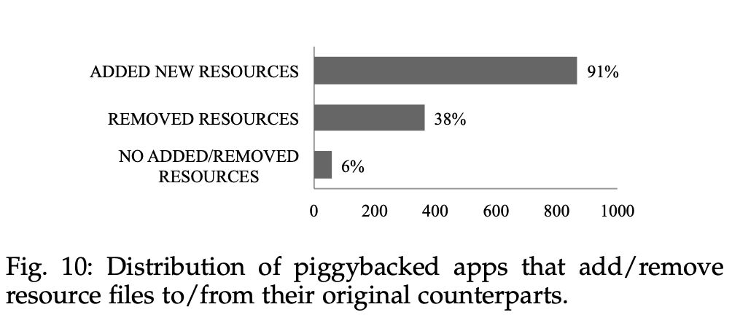
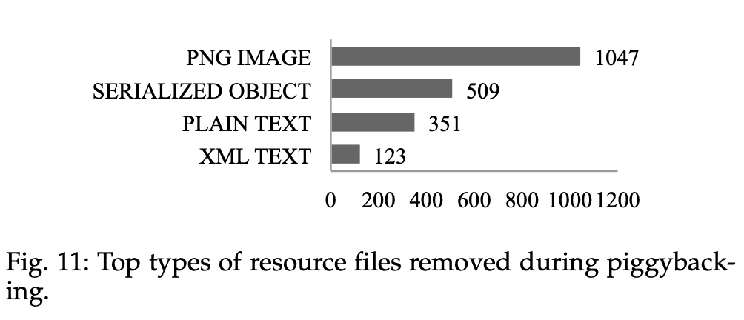
THE REALISATION OF MALICIOUS BEHAVIOUR IS OFTEN ACCOMPANIED BY A MANIPULATION (I.E., ADDING/REMOVING/REPLACING) OF APP RESOURCE FILES
F1

Slide 26
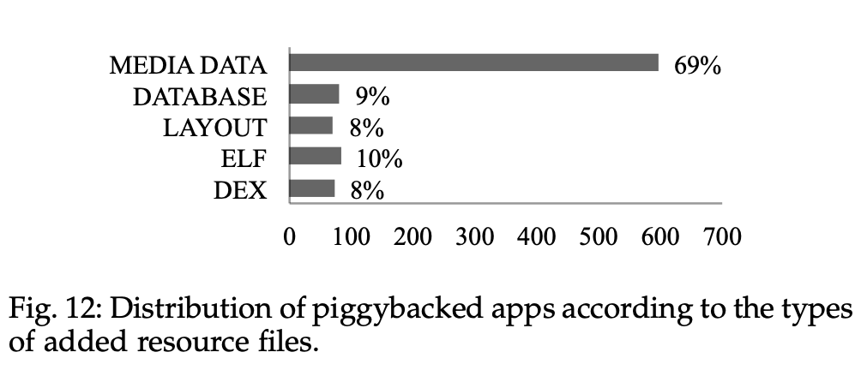
PIGGYBACKING MODIFIES APP BEHAVIOUR MOSTLY BY TAMPERING WITH EXISTING ORIGINAL APP CODE
F2
Although classes.dex remains the main site where app functionality is implemented, Android apps can carry extra code that may be invoked at runtime. We investigate the resource files added by piggybacked apps to check that they do not actually constitute the more subtle means used by malware writers to insert malicious payload. Fig. 12 shows that most of the added resources are media data (i.e., audio, video and image files). Extra DEX code have been added in only 8% of piggybacked apps. In 10% of cases, native compiled code in ELF format has been added. These results suggest that sophisticated piggybacking which manipulates extra code is still limited. In most cases, malware writers simply modify the original app code.

Slide 27
PIGGYBACKED APPS ARE POTENTIALLY BUILT IN BATCHES
F3
In our effort towards understanding app piggybacking, we investigate the developers who sign the certificates of those apps. We found that some certificates have been used for several apps. For example, RANGFEI.RSA certificate key appears in 71 piggybacked apps of our dataset, suggesting that the owner of this signature is intensively producing batches of piggybacked apps. We further consider the case of the 71 piggybacked apps signed with RANGFEI.RSA to investigate whether the developer injected similar malicious payloads in the apps. To that end, we first cluster the 71 apps through the Expectation-Maximization algorithm [34] using rider class names as features, yielding 8 clusters. We then investigate how different apps in one cluster are from apps in the others. To that end, we consider the set of labels and compute the Jaccard distance between sets of labels across clusters. We found that the clusters were highly distant (average distance > 0.7), suggesting different payloads in the associated piggybacked apps.

Slide 28
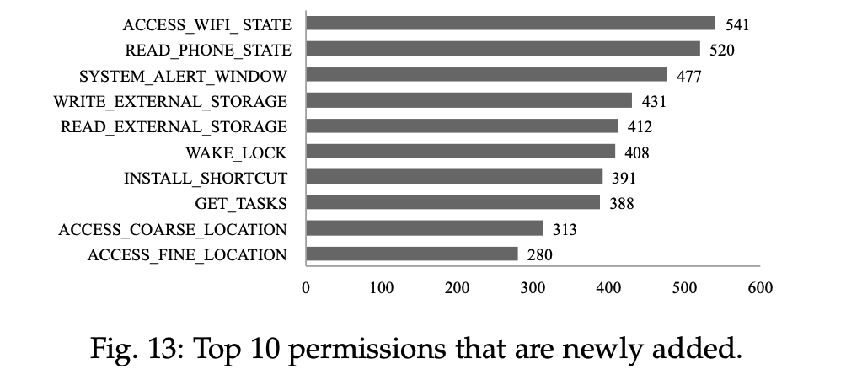
PIGGYBACKING OFTEN REQUIRES NEW PERMISSIONS TO ALLOW THE REALISATION OF MALICIOUS BEHAVIOUR
F4
For every piggybacking pair, we check in the Manifest files how requested permissions differ. We found that 812 (85%) piggybacked apps have requested new permissions that were not initially requested by their original counterparts. Fig. 13 enumerates the top 10 newly added permissions in our dataset of piggybacked apps. 6 out these 10 permissions are for allowing access to sensitive user/phone information. We note that almost half of the piggybacked apps require the WAKE_LOCK permission which enables it to keep device processor from sleeping or screen from dimming. This permission is mostly used by apps that must keep executing tasks even when the user is not actually using his device.

Slide 29
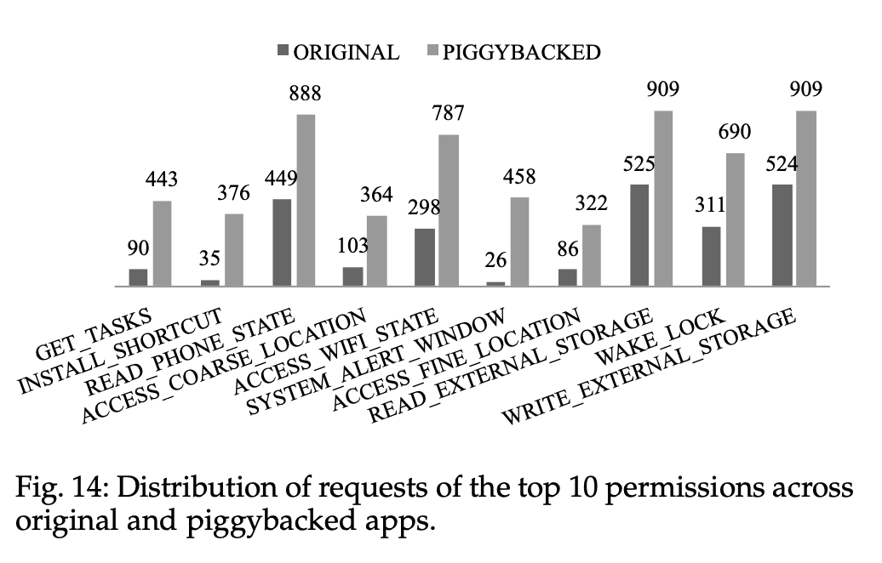
SOME PERMISSIONS APPEAR TO BE MORE REQUESTED BY PIGGYBACKED APPS THAN NON-PIGGYBACKED APPS
F5
From the newly added permissions of Fig. 13, we note that permission SYSTEM_ALERT_WINDOW, which is requested by 458 (i.e., '50%) piggybacked apps, is only requested by 26 (i.e., 3%) original benign apps (as illustrated in Fig. 14). When considering the top 10 newly added permissions only, we note that they are requested, on average, by 65% piggybacked apps and only 26% benign original apps.

Slide 30
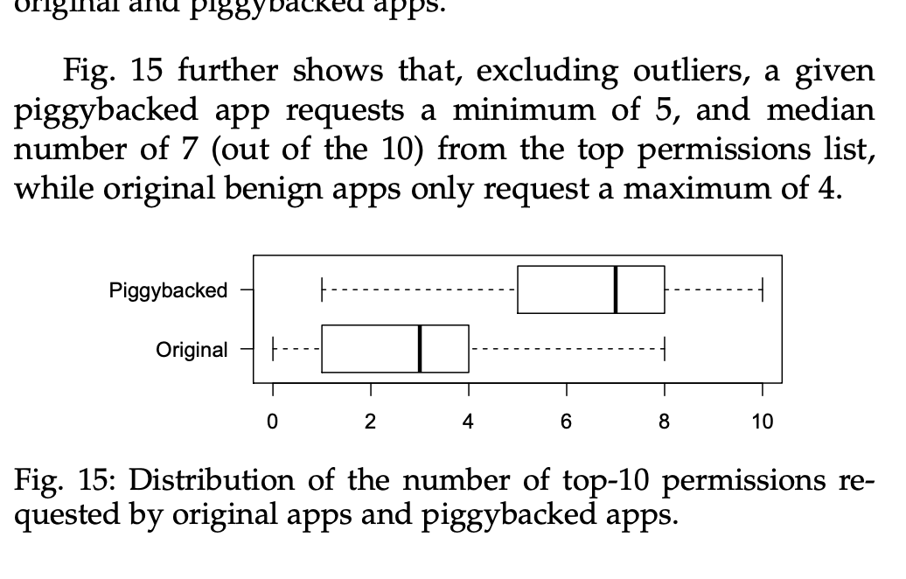
SOME PERMISSIONS APPEAR TO BE MORE REQUESTED BY PIGGYBACKED APPS THAN NON-PIGGYBACKED APPS
F5

Slide 31
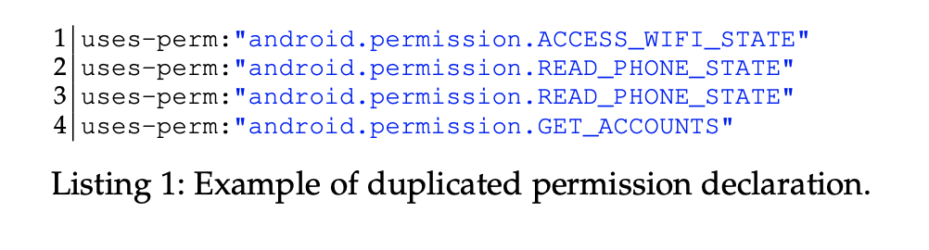
PIGGYBACKING IS PROBABLY LARGELY AUTOMATED
F6
There appears to be a simplistic automated process for adding permissions. Specifically, permission requests are frequently duplicated within the same Manifest file. For instance, the READ_PHONE_STATE permission, a commonly added permission by piggybacked apps, was systematically duplicated in 58 apps. The duplication often occurs consecutively in the Manifest file, implying an automated process rather than manual addition by a developer. In the dataset, at least one duplicate permission was found for 590 piggybacked apps, with 576 of them duplicating permissions already present in the original apps.

Slide 32
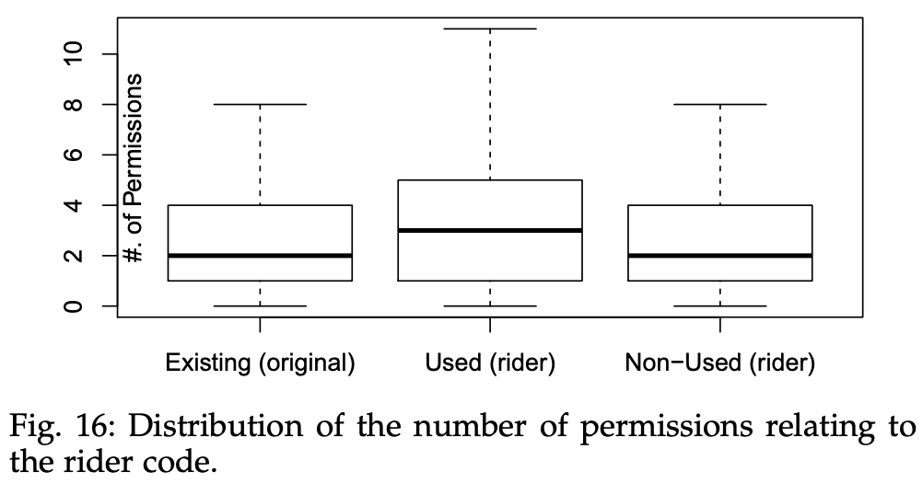
PIGGYBACKED APPS OVERLY REQUEST PERMISSIONS, WHILE LEVERAGING PERMISSIONS REQUESTED BY THEIR ORIGINAL APPS
F7
As illustrated in Fig. 15, and discussed previously, piggybacked apps appear to “systematically” include a larger set of permissions than their original counterparts. We investigate the control-flow of piggybacked apps to check whether they reached the sensitive APIs that are protected by their requested permissions (based on PScout’s results [4]). We found that 759 (or 80%) piggybacked apps have declared more permissions than necessary. This finding is inline with previous studies [8] on Android apps, including legitimate apps, which showed that app authors are usually unaware of what exact permissions are needed for the APIs leveraged in their apps. Similarly, our results suggest that piggybacked app writers are not aware of the permissions needed for the APIs accessed by their injected payloads. Fig. 16 shows that half of the piggybacked apps have requested at least two more permissions that they do not leverage. At the same time, rider code actually use APIs protected by permissions originally requested by original apps.

Slide 33
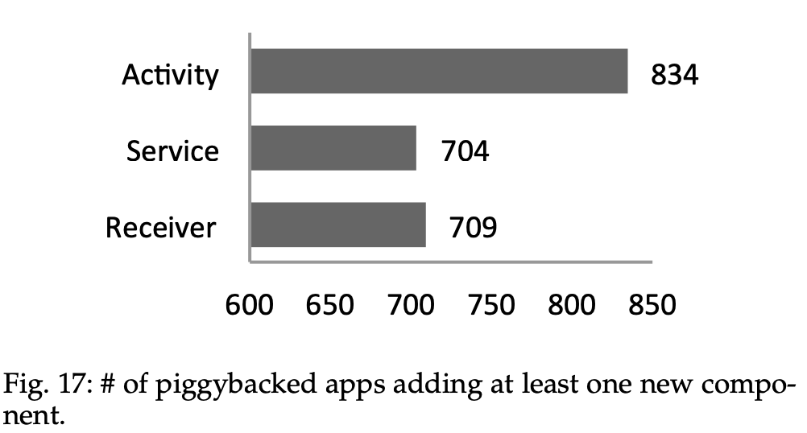
MOST PIGGYBACKED APPS NOW INCLUDE NEW USER INTERFACES, IMPLEMENT NEW RECEIVERS AND SERVICES, BUT DO NOT ADD NEW DATABASE STRUCTURES
F8
1. Activity Components Addition:
- 88% of piggybacked apps added Activity components.
- These components typically introduce new user interfaces, often for displaying advertisement pages.
- Manual checks reveal that these new components are primarily used to display advertisement pages.
2. Ad Library Integration:
- Piggybacked apps adding Activity components often integrate new ad libraries.
- Half of the piggybacked apps add multiple Activity components, possibly representing different advertisement libraries.

Slide 34
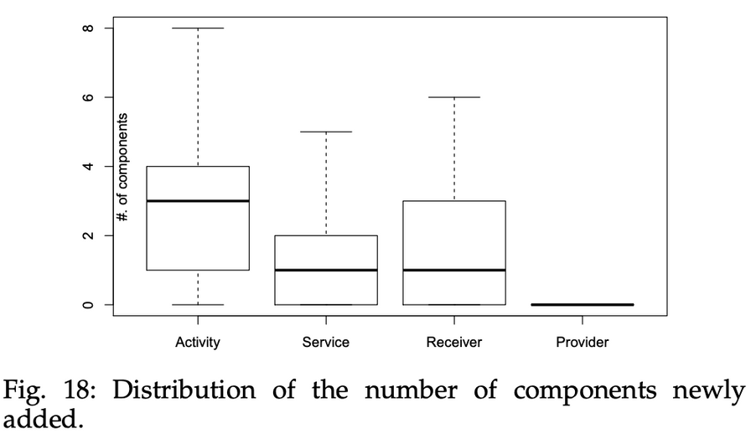
MOST PIGGYBACKED APPS NOW INCLUDE NEW USER INTERFACES, IMPLEMENT NEW RECEIVERS AND SERVICES, BUT DO NOT ADD NEW DATABASE STRUCTURES
F8
3. Service and Broadcast Receiver Components:
- Service and Broadcast Receiver components are commonly injected by piggybacking.
- Broadcast Receivers register to device events, facilitating triggering of malicious code.
- Services run background tasks, potentially depleting device resources.
4. Receiver-Service Relationship:
- In many cases, when a service is injected, a corresponding receiver is also injected.
- Receivers serve as proxies to ensure the launch of injected services.
onents.

Slide 35
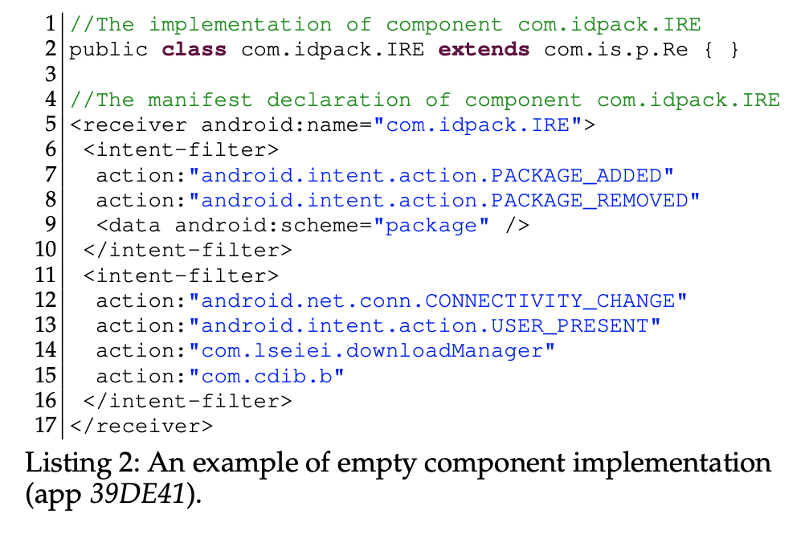
MOST PIGGYBACKED APPS NOW INCLUDE NEW USER INTERFACES, IMPLEMENT NEW RECEIVERS AND SERVICES, BUT DO NOT ADD NEW DATABASE STRUCTURES
F8
5.Empty Implementations:
-Some newly injected components ship with empty implementations, redirecting execution to parent classes.
-This indirection can be overlooked in trivial static analysis approaches, impacting the analysis of injected components.
6.Content Provider Components:
-No piggybacked apps add new Content Provider components.
-Suggests that malicious apps are not aimed at structuring data for sharing with other apps.

Slide 36
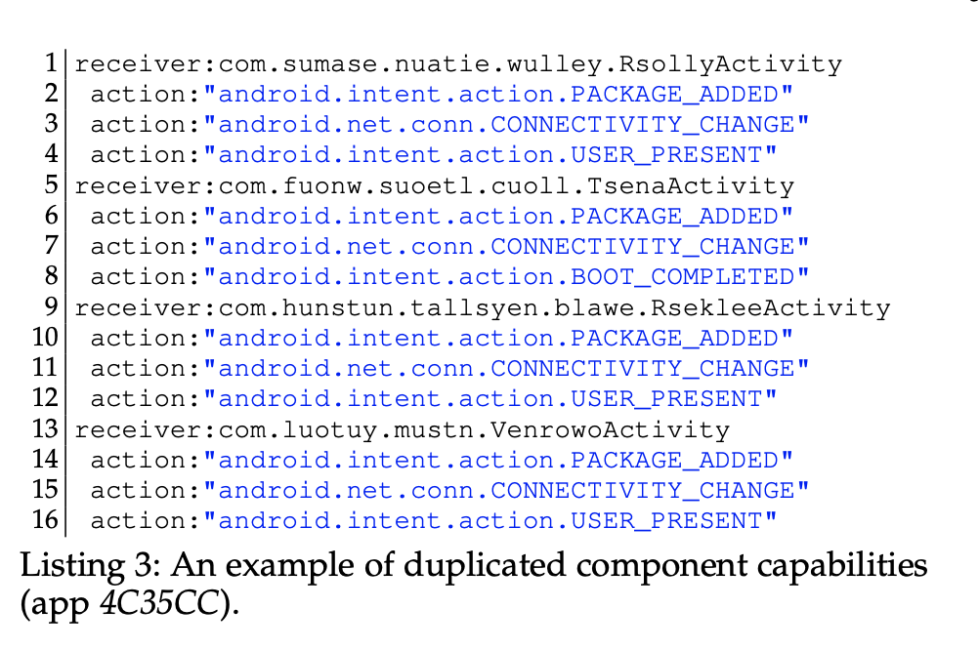
PIGGYBACKING OFTEN CONSISTS IN INSERTING A COMPONENT THAT OFFERS THE SAME CAPABILITIES AS AN EXISTING COMPONENT IN THE ORIGINAL APP
F9
Component Capability Duplication:
Piggybacking often involves adding a component with the same capability already declared for another component in the carrier app.
In 58% of piggybacked apps, multiple components share the same declared capability.
Manual Investigation Observations:
Most cases of duplicated component capabilities are associated with Broadcast Receivers.
Duplicated capabilities are likely newly injected, reflecting piggybackers' intent to maximize benefits by injecting multiple independent modules.

Slide 37
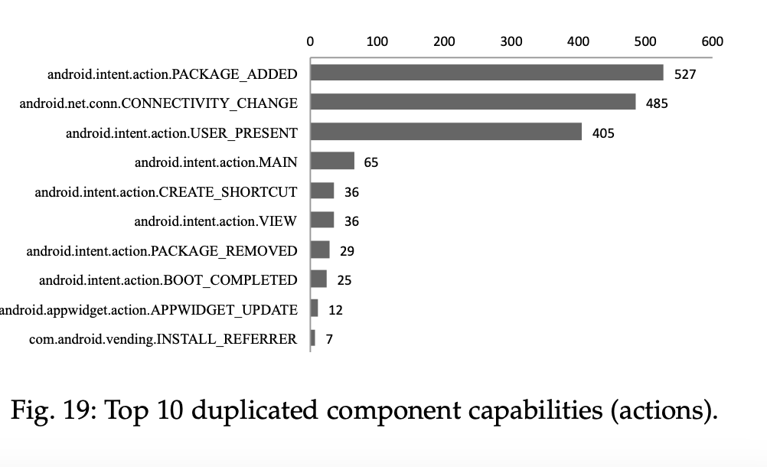
PIGGYBACKING OFTEN CONSISTS IN INSERTING A COMPONENT THAT OFFERS THE SAME CAPABILITIES AS AN EXISTING COMPONENT IN THE ORIGINAL APP
F9
Example of Duplicated Component Capabilities:
Listing 3 illustrates an example where four newly injected receivers share the same capabilities, likely from four different modules.
Top 10 Duplicated Capabilities:
Fig. 19 lists the top 10 duplicated capabilities leveraged by piggybacked apps.
The three capabilities presented in Listing 3 are identified as the most duplicated by piggybackers.
These capabilities are associated with commonly-fired system events in Android devices, such as new app installation, internet connection change, and phone unlock.

Slide 38
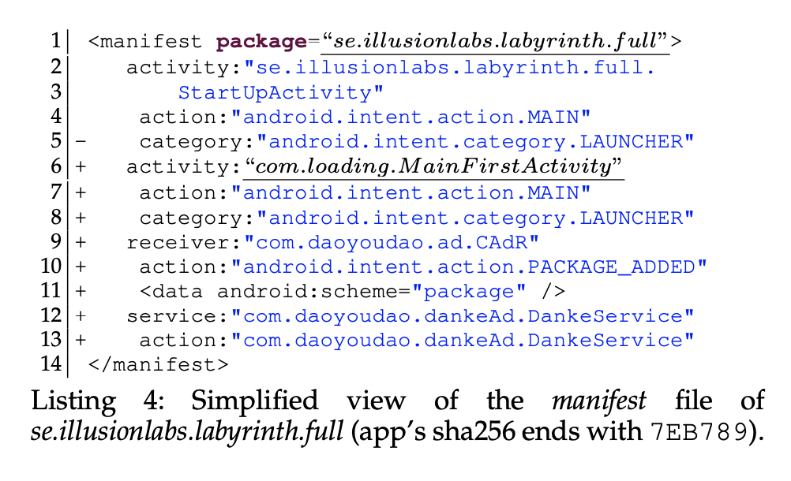
PIGGYBACKED APPS CAN SIMPLY TRICK USERS BY CHANGING THE LAUNCHER COMPONENT IN THE APP, IN ORDER TO TRIGGER THE EXECUTION OF RIDER CODE
F10
As previously explained, Android apps include in their Manifest file an Application package name that uniquely identifies the app. They also list in the Manifest file all important components, such as the LAUNCHER component with its class name. Generally Application package name and Launcher component name are identical or related identically. However, when a malware writer is subverting app users, she/he can replace the original Launcher with a component from his malicious payload. The app example from Listing 4 illustrates such a case where the app’s package (se.illusionlabs.labyrinth.full, line 1) and launcher (com.loading.MainFirstActivity, line 10) differ.

Slide 39
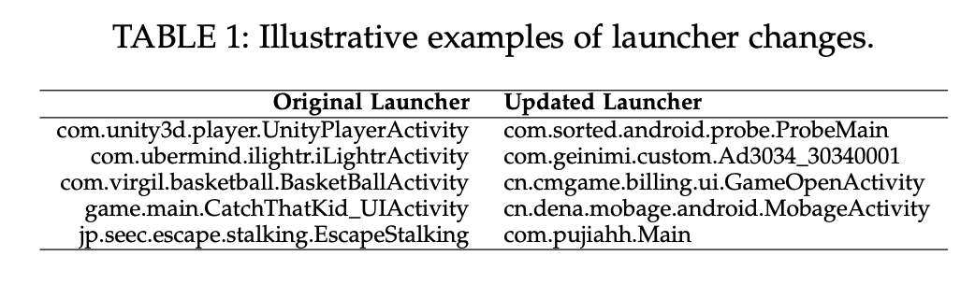
PIGGYBACKED APPS CAN SIMPLY TRICK USERS BY CHANGING THE LAUNCHER COMPONENT IN THE APP, IN ORDER TO TRIGGER THE EXECUTION OF RIDER CODE
F10
We investigate our piggybacking pairs to identify cases where the piggybacked apps has changed their LAUNCHER component, comparing to the original benign app. Table 1 illustrates some examples on the original and updated LAUNCHER. These changes in the Manifest file are essential for piggybackers to ensure that their code is run. We found 73 cases in our dataset where the piggybacked app switched the original launcher component to one component that was added as part of its rider code.

Slide 40
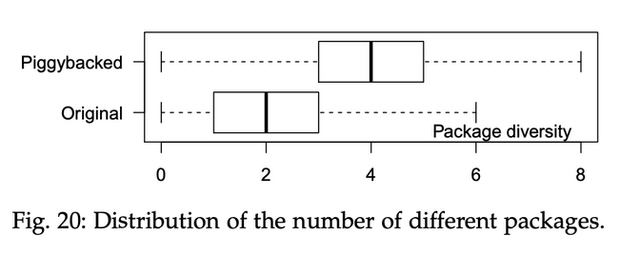
PIGGYBACKING IS OFTEN CHARACTERIZED BY A NAMING MISMATCH BETWEEN EXISTING AND INSERTED COMPONENTS
F11
Since Android apps are mostly developed in Java, different modules in the application package come in the form of Java packages. In this programming model, developer code is structured in a way that its own packages have related names with the Application package name (generally sharing the same hierarchical root, e.g., com.example.*). When an app is piggybacked, the inserted code comes as separated modules constituting the rider code with different package names. Thus, the proportions in components that share the application package names can also be indicative of piggybacking. Such diversity of package names can be seen in the example of Listing 4. The presented excerpt already contains three different packages. Since Android apps make extensive use of Google framework libraries, we systematically exclude those in our analysis to improve the chance of capturing the true diversity brought by piggybacking. Fig. 20 illustrates that piggybacked apps present a higher diversity of packages names in comparison with their original benign counterparts

Slide 41
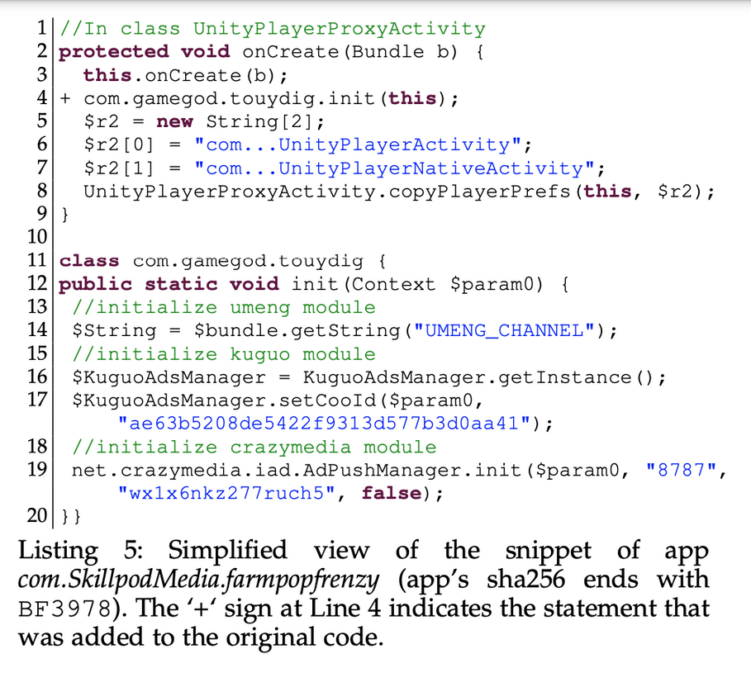
MALICIOUS PIGGYBACKED PAYLOAD IS GENERALLY CONNECTED TO THE BENIGN CARRIER CODE VIA A SINGLE METHOD CALL STATEMENT
F12
Listing 5 illustrates a snippet showing an example of type1 hook (cf. definition in Section 4.1), where the hook (line 4) is placed immediately at the beginning of the onCreate method to trigger the malicious payload when component UnityPlayerProxyActivity is activated. The fact that a static method is leveraged somewhat suggests that piggybackers attempt to pay least effort to connect benign carrier code to rider code. The simplified implementation of touydig.init() is shown in lines 11-20. Generally, this method is used to initialize three modules which are simultaneously injected by piggybackers. All the three modules, including umeng, kuguo, and crazymedia, are injected to provide advertizement and consequently to redirect the revenues from the original developers to piggybackers.

Slide 42
PIGGYBACKING HOOKS ARE GENERALLY PLACED WITHIN LIBRARY CODE RATHER THAN IN CORE APP CODE
F13
We look into the carrier method implementations where hook statements are placed. Table 3 presents the top 5 methods where hook statements can be recurrently traced to. Interestingly, all five methods are actually part of wellknown libraries that are used for benign functionality. We further found that these libraries actually propose utility functions for Game apps.

Slide 43
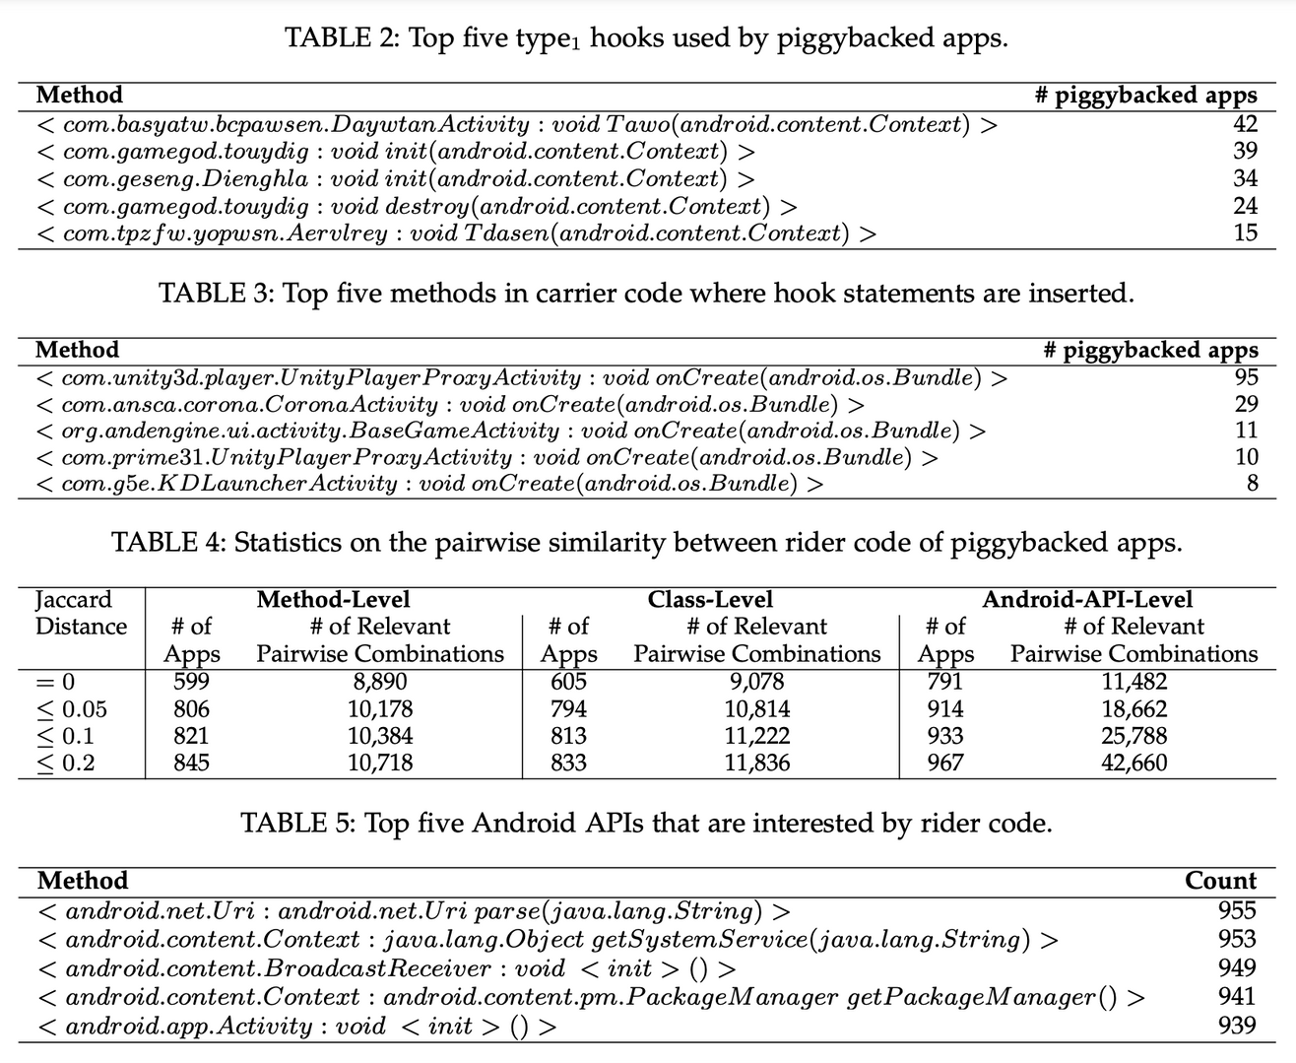
INJECTED PAYLOAD IS OFTEN REUSED ACROSS SEVERAL PIGGYBACKED APPS
F14

Slide 44
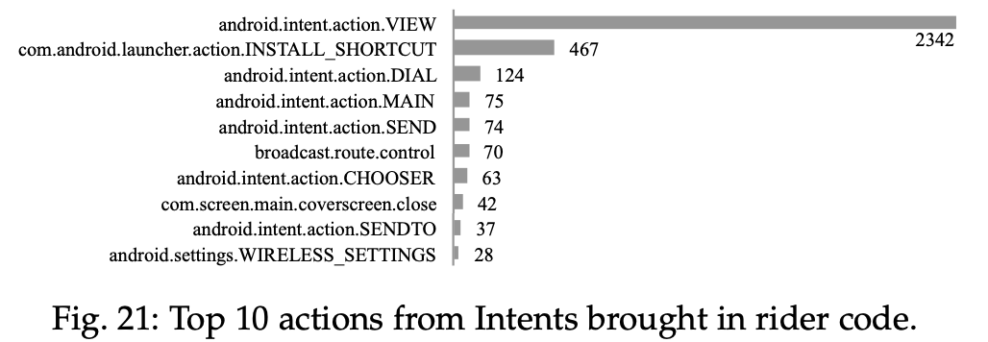
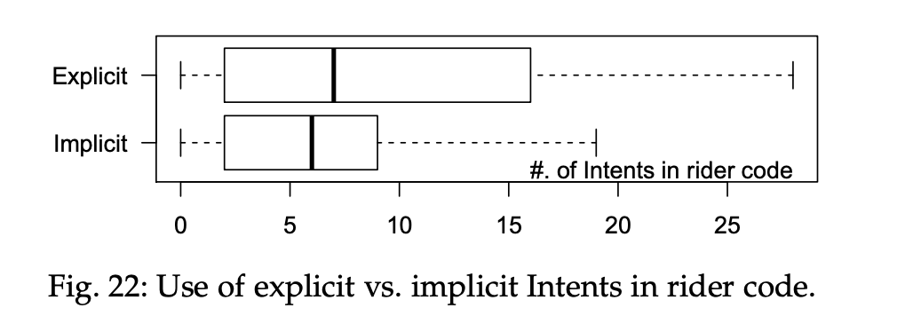
PIGGYBACKING ADDS CODE WHICH PERFORMS SENSITIVE ACTIONS, OFTEN WITHOUT REFERRING TO DEVICE USERS
F15
1. Role of Intents:
- Intents serve as special objects facilitating data exchange across Android app components.
- Allows components to reuse functionalities implemented in other components within or outside the app.
- Intent objects include an action field indicating the desired operation on the exchanged data.
2. Top Actions in Rider Code Intents:
- Fig. 21 lists the most common actions observed in all intents used by rider code across piggybacked apps.
- Many intents involve transferring data for viewing, often associated with displaying advertisements.
- Other actions include installing shortcuts, performing dialing, sharing data outside the app, etc.
- Notably, two of the top actions are user-defined, confirming the reuse of payloads across apps.
3. Implicit vs. Explicit Intents:
- Intents can be implicit (user selects the component to realize the action) or explicit (a specific component is designated, bypassing user choice).
- Fig. 22 indicates that piggybacking rider code tends to use more explicit intents than implicit intents.
- This contrasts with benign apps, which, as shown in previous research, lean towards using more implicit intents for showing activities.

Slide 45
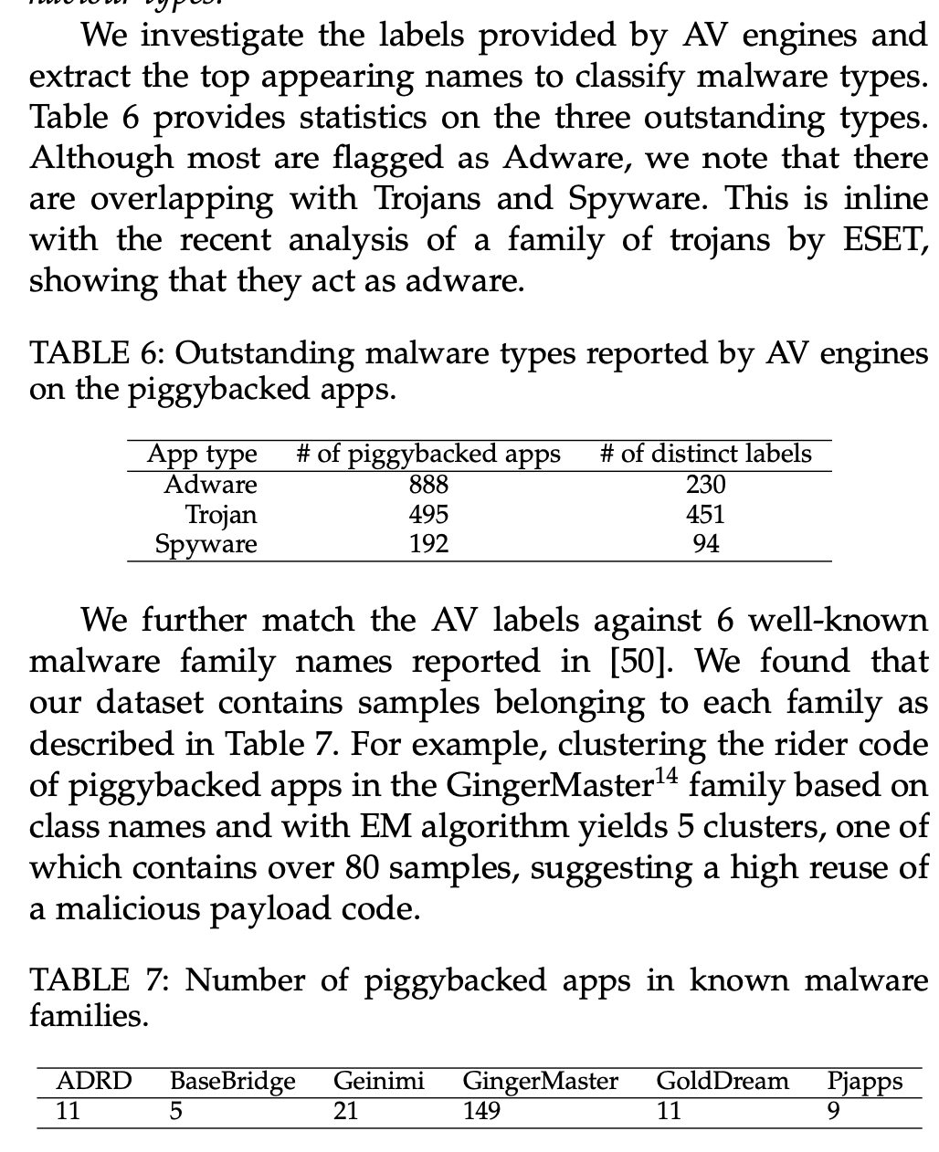
PIGGYBACKING OPERATIONS SPREAD WELL-KNOWN MALICIOUS BEHAVIOUR TYPES
F16

Slide 46
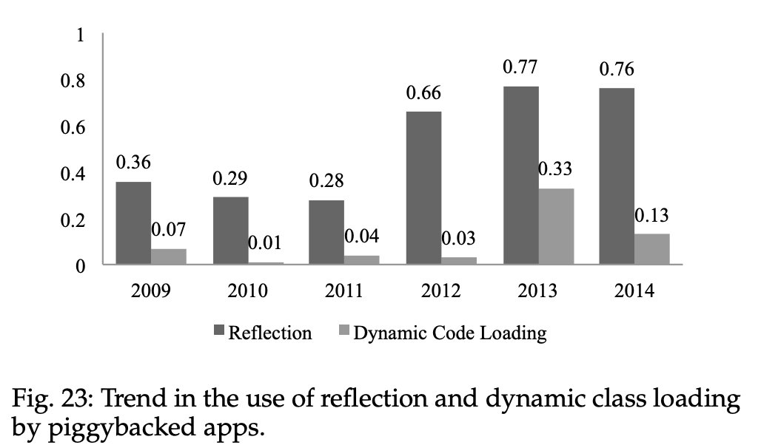
PIGGYBACKED APPS INCREASINGLY HIDE MALICIOUS ACTIONS VIA THE USE OF REFLECTION AND DYNAMIC CLASS LOADING
F17
The Android system provides DexClassLoader, a class loader that loads classes from .jar and .apk files. It can be used by malware writers to execute code not installed as part of their apps. We found 185 (19%) piggybacked apps whose riders dynamically load code. Such schemes are often used by malware writers to break the control-flow of app, and thus challenge static detection of suspicious behaviour [30], [31]. Fig. 23 provides the ratio of piggybacked apps using reflection and dynamic code loading. The ratio has substantially improved in recent years.

Slide 47
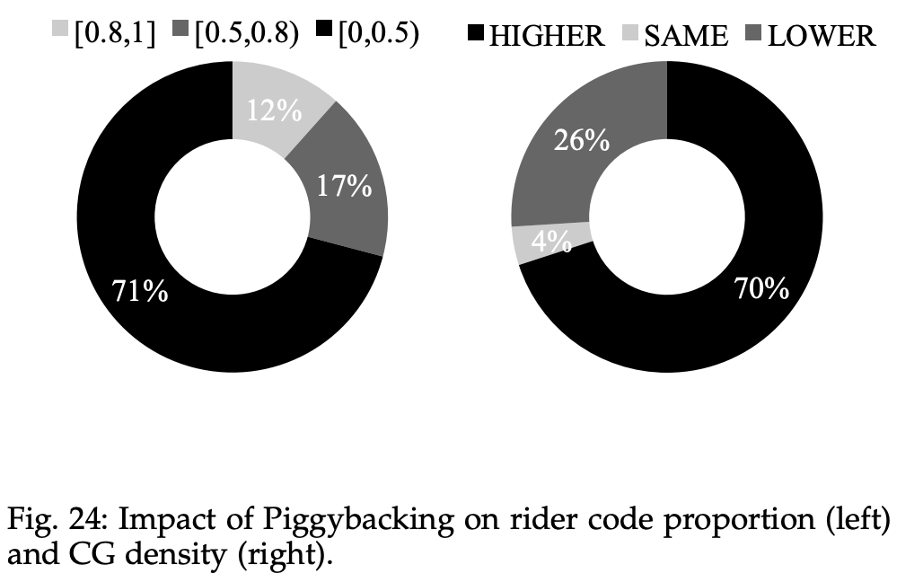
PIGGYBACKING CODE DENSIFIES THE OVERALL APP’S CALL GRAPH, WHILE RIDER CODE CAN EVEN LARGELY EXCEED IN SIZE THE CARRIER CODE
F18
Proportion of Rider Code:
Fig. 24 (left) reveals that for 71% of piggybacked apps, the rider code is smaller than the carrier code.
However, for 29% of apps, the rider code exceeds the carrier code in terms of Lines of Code (LOCs).
Call Graph Density Comparison:
Call graphs of piggybacked apps are compared to those of their corresponding original apps.
The density metric, computed using the ratio of real edges to total possible edges, is examined.
Fig. 24 (right) shows that piggybacking code generally increases the call graph density.
This increase is often achieved by injecting complex rider code, making it challenging for analysts to understand.
In 1/4 cases, the call graph density has decreased, primarily observed in piggybacked apps using type2 hooks (via events). Only a few apps maintained the same density metric values.

Slide 48
PIGGYBACKED APP WRITERS ARE SELDOM AUTHORS OF BENIGN APPS
F19
We investigate the certificates used to sign the apps in our dataset. We collected 703 distinct certificates in original apps against only 194 distinct certificates in piggybacked apps. We only found 14 certificates where each have been used to sign both a piggybacked and another app in the set of originals. Looking into those certificates, we found that it is inline with the well-known copy/paste problem. As an example, we have found that a certificate issued to Android Debug, which should only be used to develop and test an app, is applied to released apps. Several of the overlapping certificates were actually due to this issue.

Slide 49
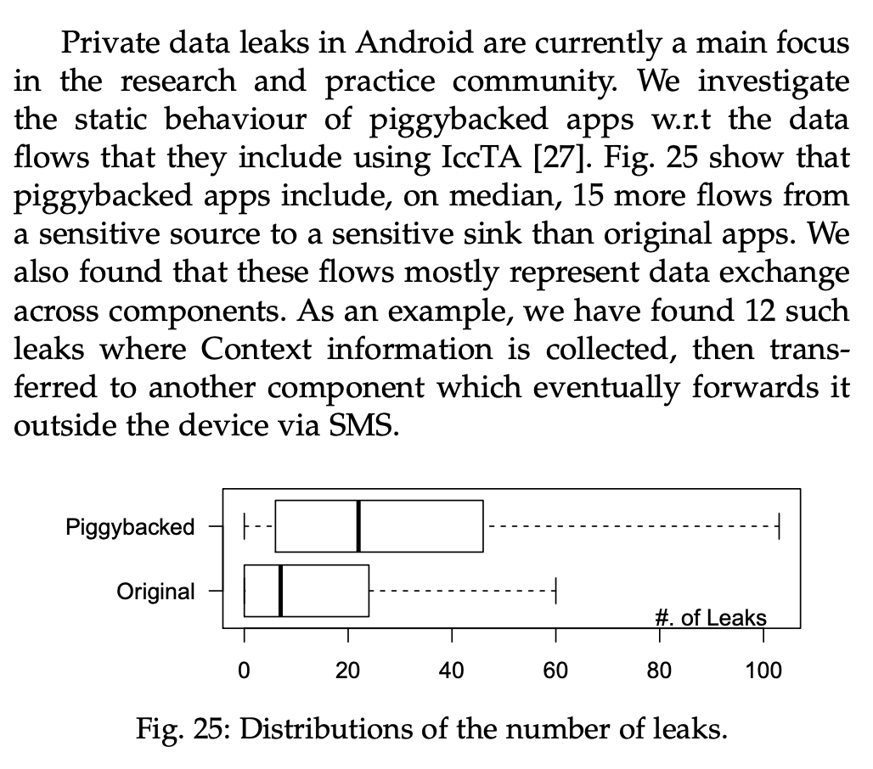
PIGGYBACKING CODE BRINGS MORE EXECUTION PATHS WHERE SENSITIVE DATA CAN BE LEAKED
F20

Slide 50
POTENTIAL OUTCOMES
Detection of Piggybacked Apps:
The study aims to inspire new research in the automated detection of piggybacked apps, similar to the MalGenome project.
Calls for the development of machine learning-based approaches that effectively model piggybacking, avoiding the impractical need for pairwise comparisons.
Suggests the possibility of treating piggybacked detection as a classification problem, allowing the identification of piggybacked apps without the need for original counterparts.
Explainable Malware Detection:
Highlights the limitations of current generic machine learning classifiers for Android malware detection.
Advocates for the exploration of piggybacked apps to retrieve various malicious payloads, enabling the inference of fine-grained semantic features for more effective and explainable malware detection.
Malicious Code Localization:
Emphasizes the relevance of understanding how malicious code is hooked into benign app code.
Offers insights into potentially discriminative code features for statically identifying malicious parts within apps.
Presents preliminary experiments showing an 83% accuracy in automatically localizing hook code, even without knowledge of the original counterparts of dissected piggybacked apps.

Slide 51
THREATS TO VALIDITY
The study acknowledges potential threats to its validity. The dataset's exhaustivity is a concern, but efforts were made to leverage the extensive AndroZoo research dataset, spanning six years and encompassing various malware families. A limitation is the exclusion of recent apps due to delayed AV report collection. However, continuous updates are planned. The focus on accurate, obvious piggybacking pairs, rather than exhaustive detection, was a deliberate choice. The uncertainty about the true original app in ground truth pairs remains a potential challenge for future research. AV labels may have imperfections due to disagreements, and the dataset only considers piggybacking by different developers. The study also notes the existence of Android app packers, which may complicate piggybacking, although current approaches can still extract DEX code from packed apps.

Slide 52
ConculusioN
We have investigated Android piggybacked apps to provide the research community with a comprehensive characterisation of piggybacking. We then build on our findings to put in perspective some common assumptions in the literature. We expect this study to initiate various research directions for practical and scalable piggybacked app detection, explainable malware detection, malicious code localization, and so on.

Slide 53
pros
cons
Detailed research with real world data
Good similarity metrics
Best effort to elimate f/p
Too much trust to Virustotal, some cases can bypass detection
Is piggybacking still a security concern ?
Obsucated, packed codes has eliminated

Slide 54
FUTURE
WORK
DIRECTION
Systems for live monitoring piggybacking cases
AI based approaches for detection
Localization and disarming
More understanding with dynamic analysis
Live monitoring and generate IOC data

Slide 55
THANK YOU

